Slide 1
Notes:
My name is Kristian Bennett
CEO, Founder, Person of charge of Nsights
We are a new software for financial advisors to help run their investment / pensions

Slide 2
(ICP) Commission – Led Advisors
Recommend products , renumerated by product provider
Financial Generalists
Micro – SME’s / Limited Resources
Majority AUA & Clients
“Broker” model & advisor revenue under pressure because ;
Tightening regulations
Harder to demonstrate value to clients
Notes:
Our ideal client profile in particular are not only financial advisors but specifically COMMISSION – LED financial advisors
Quick overview of commission led -…….
These advisors recommend products , usually funds ,
They are normally financiall generalists for example, they will sell a mortgage in the morning, car insurance before lunch, health or life cover after lunch , then in the evening will recommend an investment fund , 90% via a pension product
Over 90% in Ireland , similar elsewhere are micro-SME’s , less than 10 employees, less than €2m revenue
Majority of assets under advice, here in Ireland its about €120bn which is 60% , i

Slide 3




Typical Commission – Led Conflict
Clients
Advisor
50 Years of Age
Seeking pension advice
Two legacy policies
€300k Value
No New Product = No Commission
Consolidate
Use existing provider
New risk assessment
Re-config fund choices
Notes:
Just to drive home the issue here, lets take a quick but very example
Mary or John , 50 years of age, starting to thing about like post work.
They have two legacy pensions from previous work schemes.
€300k looking for advice, as they

Slide 4






Typical Commission – Led Conflict
Clients
Advisor
50 Years of Age
Seeking pension advice
Two legacy policies
€300k Value
No New Product = No Commission
Consolidate
Use existing provider
New risk rating
Re-config fund choices
€12k Upfront
€1.5k Recurring
€0k Existing
€1.5k Recurring
€6k Upfront
€1.5k Recurring
€0k Existing
€1.5k Recurring
€12k Upfront
€1.5k Recurring
€18k Upfront
€1.5k Recurring

Slide 5

Justify Upfront Commission =
Demonstrate Research / Rationale
Regulatory Problem
Justify Recurring Commission =
Annual suitability reports
Longevity Problem
Demonstrate Value Add

Slide 6

Solution
One-Click Investment Research & Rationale
Automated suitability reports via CRM data
Graphs, visuals on all topics, concepts & client FAQ
Embedded Agentic AI Investment specialist

Slide 7

Solution
One-Click Investment Research & Rationale
Automated suitability reports via CRM data
Graphs, visuals on all topics, concepts & client FAQ
Embedded Agentic AI Investment specialist
Upfront Commission
Recurring Income
Demonstrating Value Now
Upskilling for future

Slide 8
Business Model
AI Agentic
Small Language Model
Qualitative Inputs
Regional Investment Distribution
Regional Tax / Pension Laws
Regional Best FP Best Practice
nSights Ltd
nSights Platform
SAAS
Web –Based App
Cloud Hosted
Product Led
Monthly Subscription Cycle
Nsights Users
Financial Advisors
Fund Performance Feeds
Investment Market Feeds
Economic Data Feeds
Quantitative Inputs

Slide 9

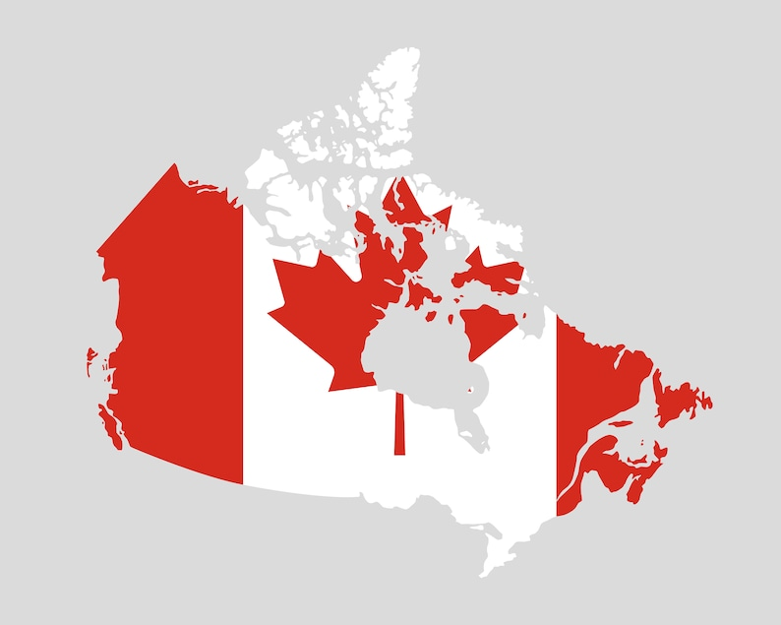

Market Opportunity
# of Firms | 2,500
% Share of Assets | 60%
% Share of Clients | 80%
Est Average Rev | €3,096
Targt Markt (20%) | 500
Forecast Rev 2028 | €1.6m
# of Firms | 28,519
% Share of Assets | -
% Share of Clients
Est Average Rev | €3,000
Targt Markt (2%) | 575
Forecast Rev 2028 | €1.7m
# of Firms | 16,750
% Share of Assets | -
% Share of Clients
Est Average Rev | €3,000
Targt Markt (2%) | 375
Forecast Rev 2028 | €1m

Slide 10

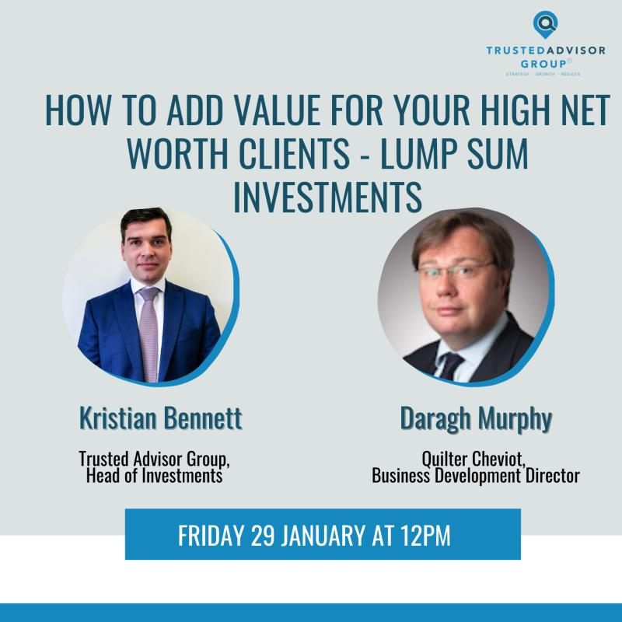






Route to Market & Traction
10 Paying Trials
Prototype
Idea Validation
2,500 Firms
Highly Targeted
Memorable Ads
B & C Audience
Thought Leadership Partnerships
Conferences
Surveys

Slide 11
The Ask & Financials
Funding €125k
Pre – Money Valuation | €1.1m
Funding Round | €125k
Post Money Valuation | €1.225m
Post Money Investor Shareholding 10%
 | (-50%) | BASE CASE | (+50%)
EBITDA | € 1,335,495 | € 2,670,990 | € 4,006,485
Lower Mid Range Multiple (8x) | € 10,683,960 | € 21,367,920 | € 32,051,880
Return Multiple | 8.5X | 17.1X | 32.1X
Money Return (€125k) | € 1,068,396 | € 2,136,792 | € 3,205,188
IRR | 106% | 161% | 196%
# Clients
75
# Clients
225
217
144
# Clients
500
543
362

Slide 12
Notes:
My name is Kristian Bennett
CEO, Founder, Person of charge of Nsights
We are a new software for financial advisors to help run their investment / pensions

