Slide 1

Investment Markets

Slide 2

2024 Global Equity markets at a glance
Source: Bloomberg , Financial Express. Performance figures are to 30 / 04 / 2024 . For illustration purposes only.

Slide 3
ESMA 3
ESMA 5
ESMA 6

Slide 6
Continued momentum from 2023
The equity market performance is a continuation of an extremely strong 2023 which saw all major stock market indices up between 20 and 30 % .
Source: Bloomberg , Financial Express. Performance figures are to 30 / 04 / 2024 . For illustration purposes only.

Slide 7
US Markets leading the way globally
Equity markets in the US account for c60% of the world equity market. Performance of the US market has been extremely strong for the past decade. In particular, the technology sector , represented by the Nasdaq Composite, has been a standout performer.
Source: Bloomberg , Financial Express. Performance figures are to 30 / 04 / 2024 . For illustration purposes only.

Slide 8
Global Equity Market Annualised Performance
Equity markets in the US account for c60% of the world equity market. Performance of the US market has been extremely strong for the past decade. In particular, the technology sector , represented by the Nasdaq Composite, has been a standout performer.
Source: Bloomberg , Financial Express. Performance figures are to 30 / 06 / 2024 . For illustration purposes only.

Slide 9
Global Equity Style Performance
The continued outperformance of growth / technology stocks , despite “higher for longer” interest rates, has some market commentators calling a bubble. However, earnings for the mega-cap growth / tech names remain robust, so far.
Source: Bloomberg , Financial Express. Performance figures are to 30 / 04 / 2024 . For illustration purposes only.

Slide 10
Global Equity Style Performance Annualised
Source: Bloomberg , Financial Express. Performance figures are to 30 / 04 / 2024 . For illustration purposes only.

Slide 11
Global Fixed Income Indices Performance
Bond market recovery has stalled during March & April 2024 as inflation is proving sticker than anticipated , reducing the number forecast interest rate cuts casing yields to rise (prices fall) .
Source: Bloomberg , Financial Express. Performance figures are to 30 / 04 / 2024 . For illustration purposes only.

Slide 12
Global Fixed Income 5 Year Performance
Interest rate rises , particularly when yields are at record low levels, is bad for fixed income performance. After a record bad 2022, yields and thus prices have recovered some losses. A more normalised yield environment is welcomed by most market participants.
Source: Bloomberg , Financial Express. Performance figures are to 30 / 04 / 2024 . For illustration purposes only.

Slide 13
Global Fixed Income Annualised Performance
The 2022 bond market “rout” reduced nearly all 5-year fixed income performance to negative figures . There has been some recovery since but low risk investors are realising very low single digit returns for a 10-year period.
Source: Bloomberg , Financial Express. Performance figures are to 30 / 04 / 2024 . For illustration purposes only.

Slide 14
“Magnificent 7” performance 2 years
The so-called “Magnificent 7” are a combination of the most valuable companies by market capitalisation in the world. They current account for c30% of the S&P 500 and thus their individual performance has a big impact on the market performance

Slide 15
US Equity Markets 10 Years Performance
Equity markets in the US account for c60% of the world equity market. Performance of the US market has been extremely strong for the past decade. In particular, the technology sector has outperformed al other sectors.

Slide 16
Fixed Income performance has stabilised
Interest rate rises , particularly when yields are at record low levels, is bad for fixed income performance. After a record bad 2022, yields and thus prices have stabilised. A more normalised yield environment is welcomed by most market participants.

Slide 17
“Best” and “Worst” S&P500 Performance
This chart shows the best and worst annualised performance for the S&P 500 over different time periods. The longer time horizon you have to invest dramatically increases the probability of a positive return.

Slide 18
Time in the Market not Timing the Market
The above chart shows the value of €10,000 invested in the S&P 500 on 1st Jan 2002 and let grow until 31st December 2021. As you can see, missing even a small number of the best performing days over a 20-year period can have a dramatic negative effect on total returns.

Slide 19
Yearly market performance & intra-year Drawdown

Slide 20
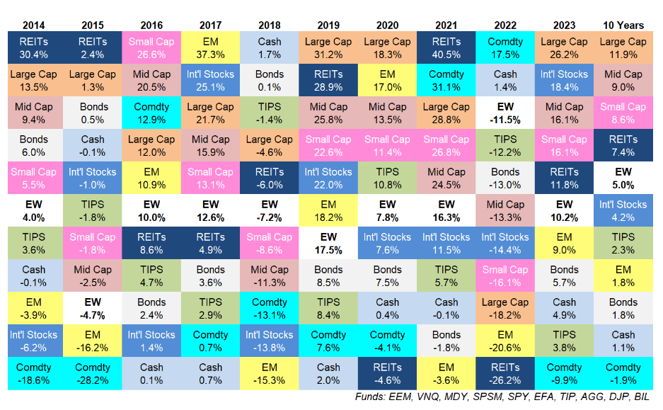
Global Asset Classes Returns

Slide 21
Why Invest? To protect the Real Value of Money

Slide 22
The best time to start investing is Now

